Slide 1
Big Data Analysis
Spark part 6

Slide 2
Spark 06 - Spark Applications

Slide 3
Lecture Objective
Explore Spark Applications in different areas, such as spam detection, page rank, information query, and sentimental analysis, etc.

Slide 4
SMS Spam Detection
Refer to the code: LabS06_1_SMSSpam
classic spam classification example using MLLib naive Bayes

Slide 5
Page Rank
PageRank (PR) is an algorithm used by Google Search to rank web pages in their search engine results. It is named after both the term "web page" and co-founder Larry Page. PageRank is a way of measuring the importance of website pages.
PageRank works by counting the number and quality of links to a page to determine a rough estimate of how important the website is. The underlying assumption is that more important websites are likely to receive more links from other websites
PageRank - Wikipedia

Slide 6
Page Rank
Refer to the code: LabS06_2_PageRank
from pyspark import SparkConf, SparkContext
sc = SparkContext.getOrCreate(SparkConf())
def f(x):
links=x[1][0]
rank=x[1][1]
n=len(links.split(","))
result=[]
for s in links.split(","):
result.append((s,rank*1.0/n))
return result

Slide 7
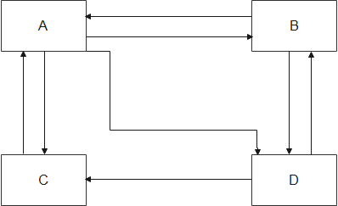
Page Rank
Refer to the code: LabS06_2_PageRank
data=sc.textFile("pagerank.txt")
link=data.map(lambda x:(x.split(":")[0],x.split(":")[1]))
#print out initial value
for x in link.collect():
print(x)
rank=link.mapValues(lambda x:1.0)
for i in range(20):
rank=link.join(rank).flatMap(f)\
.reduceByKey(lambda x,y:x+y)\
.mapValues(lambda x:0.15+0.85*x)
#print out result
rank.sortByKey().collect()
pagerank.txt
A:B,C,D
B:A,D
C:A
D:B,C
[('A', 1.2982456030107459), ('B', 0.900584798996418), ('C', 0.900584798996418), ('D', 0.900584798996418)]

Slide 8
Movie Page Rank
Refer to the code: LabS06_3_MovieRank
processed-movie-links.txt

Slide 9
Analyzing Startup Companies
Refer to the code: LabS06_4_Startup
companies.json

Slide 10
Flight Delay Analysis
Refer to the code: LabS06_5_FlightDelayAnalysis
airline-delays.csv

Slide 11
Sentimental Analysis
Refer to the code: LabS06_6_SentimentalAnalysis

